Slide 1
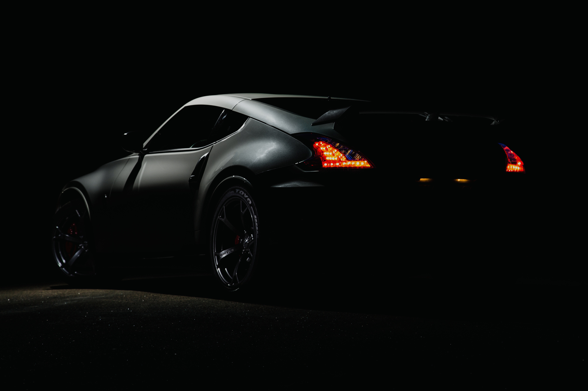
SELF-DRIVING SIMULATION USING CNN
1

Slide 2



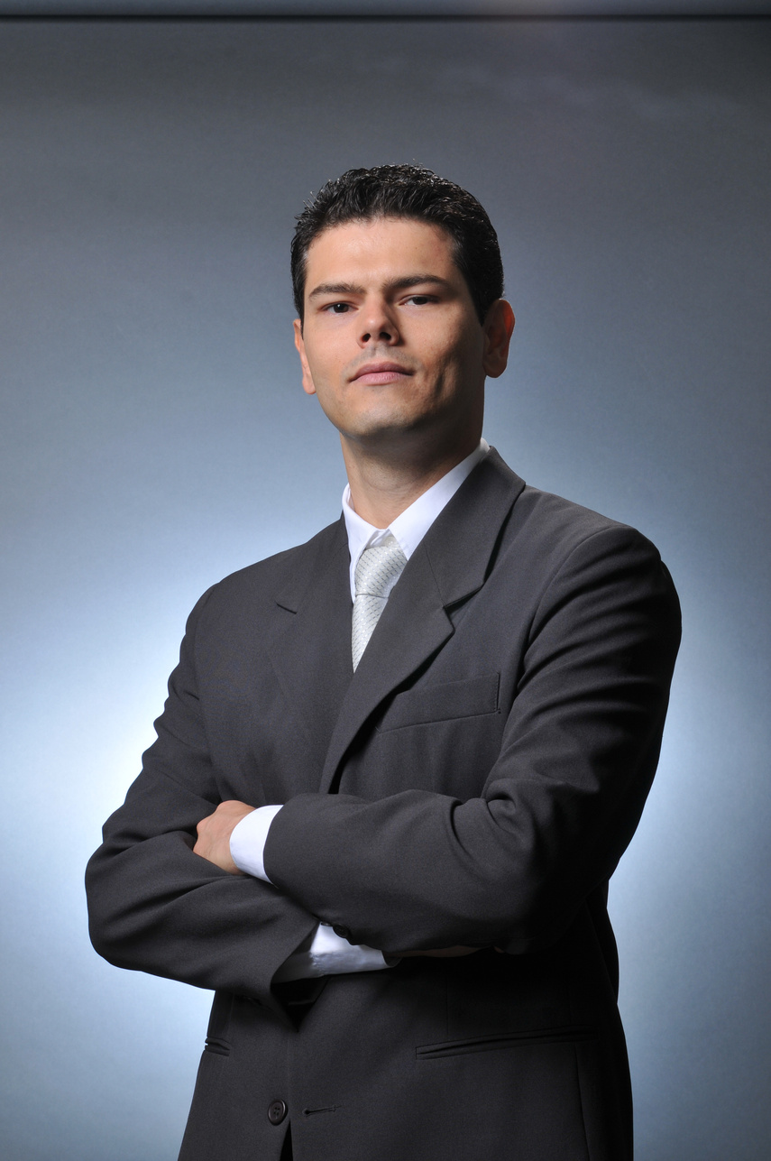





OUR TEAM
Michael George
Samaa Osama
Nourhan Sameh
Gracie Medhat
Rahma Hassan
2

Slide 3

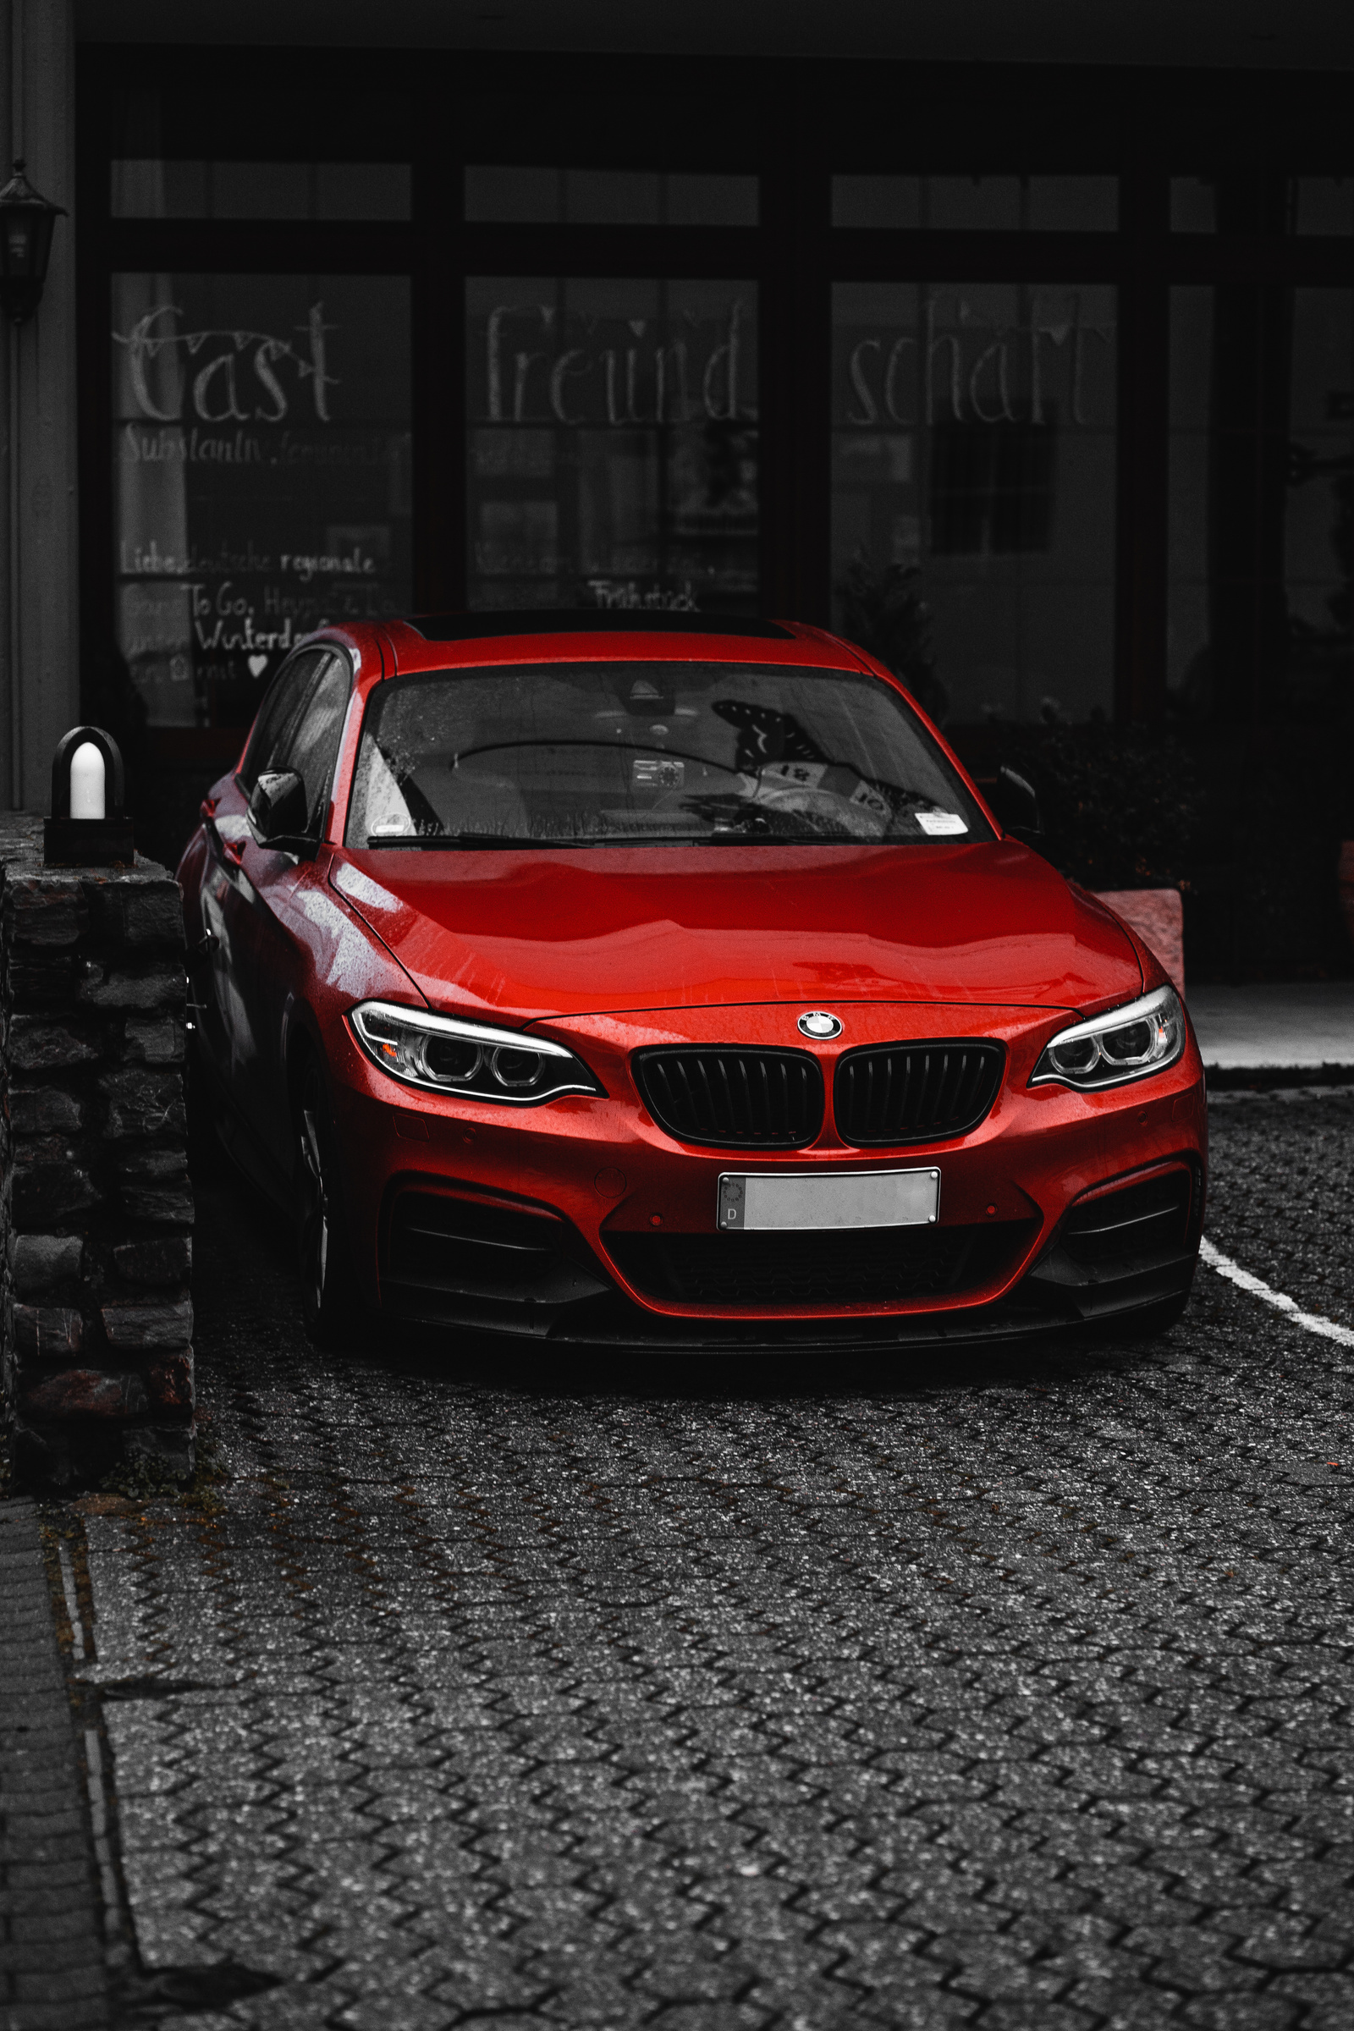
Introduction to (CV) and (CNNs)
Computer Vision (CV):
Enables machines to interpret and understand visual data.
Used in self-driving cars for object detection, lane detection, and path planning.
Convolutional Neural Networks (CNNs):
A type of deep learning model that processes visual data efficiently.
Extracts features from images for tasks like image recognition and classification.
Key component in end-to-end learning for self-driving technology.
3

Slide 4




Simulated Environment
Data collected from a driving simulator.
Captures images from front, left, and right cameras.
Labels include steering angles for supervised learning.
01
Data Collection
Real-world Data Considerations
Possible expansion to real-world images for better generalization.
02
4

Slide 5
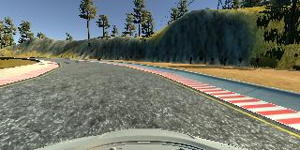
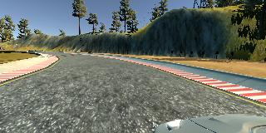
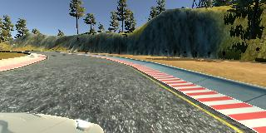
Center
01
Left
02
Right
03
4

Slide 6
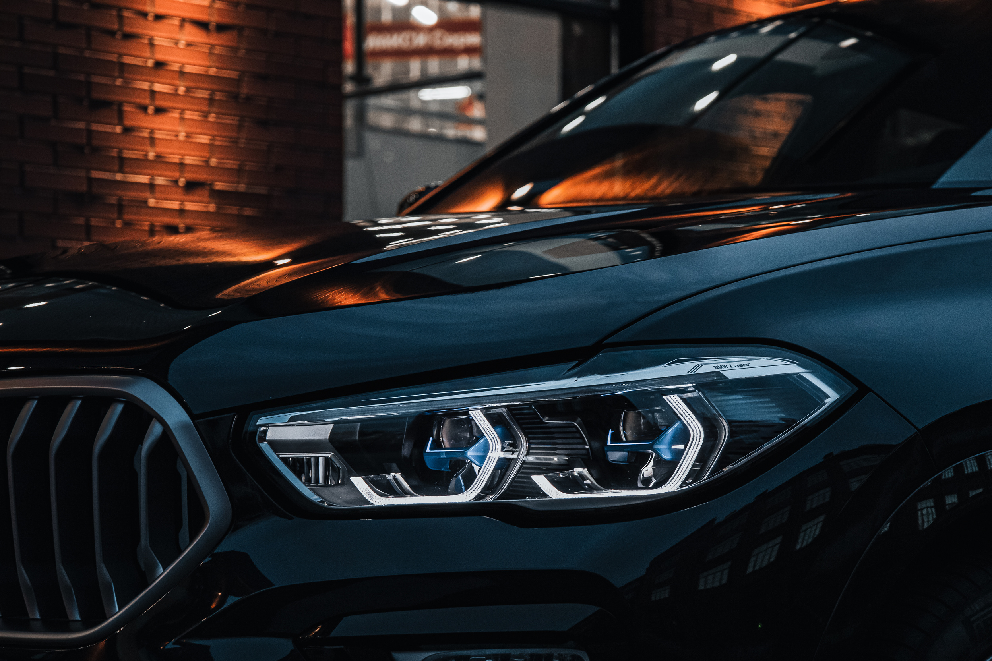
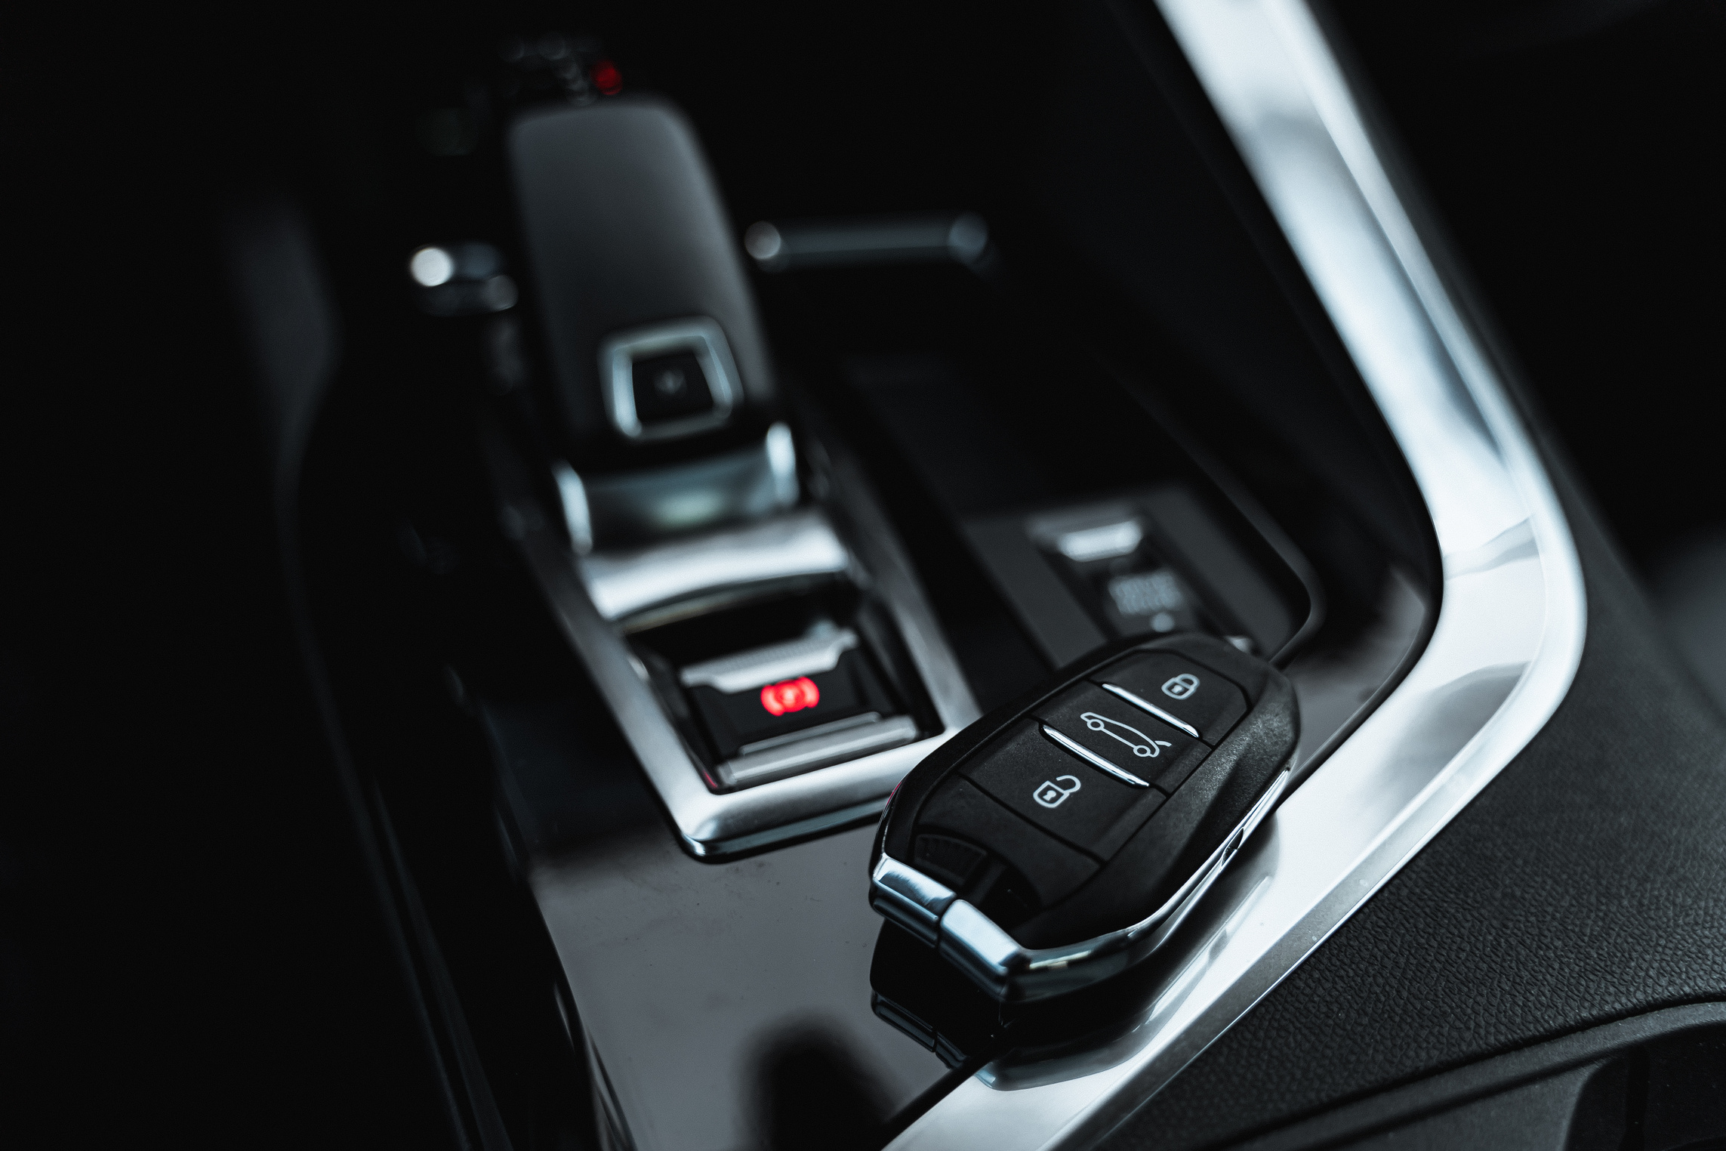
Techniques Used:
Removing overrepresented straight-driving images.
Enhancing underrepresented turning scenarios.
Data Balancing
Why Data Balancing Matters:
Ensures the model does not favor a specific type of road scenario.
Prevents bias in steering predictions.
Techniques Used:
Removing overrepresented straight-driving images.
Enhancing underrepresented turning scenarios.
5

Slide 7
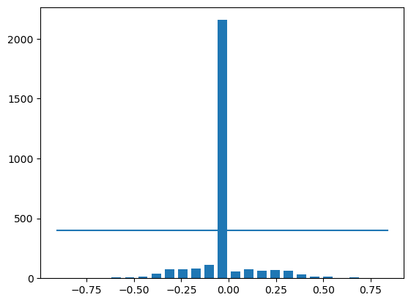
Techniques Used:
Removing overrepresented straight-driving images.
Enhancing underrepresented turning scenarios.
Before Balancing
5

Slide 8
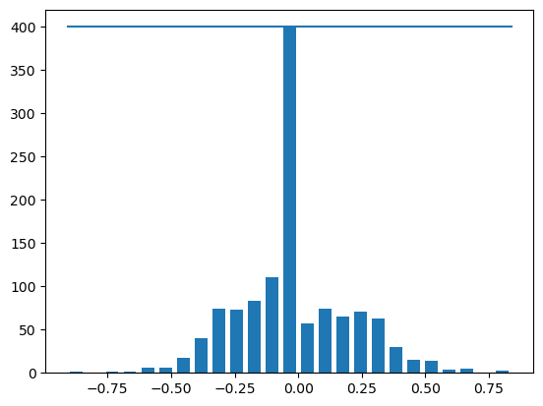
Techniques Used:
Removing overrepresented straight-driving images.
Enhancing underrepresented turning scenarios.
After Balancing
5

Slide 9
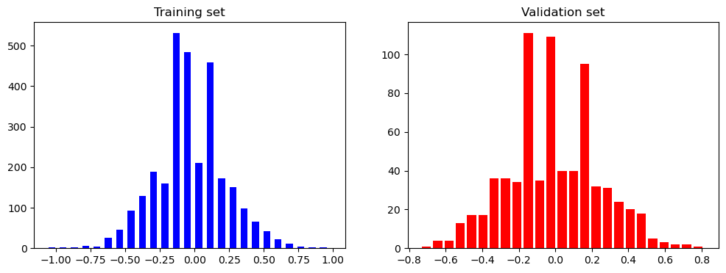
Techniques Used:
Removing overrepresented straight-driving images.
Enhancing underrepresented turning scenarios.
Training and Validation Set are normally distributed
5

Slide 10

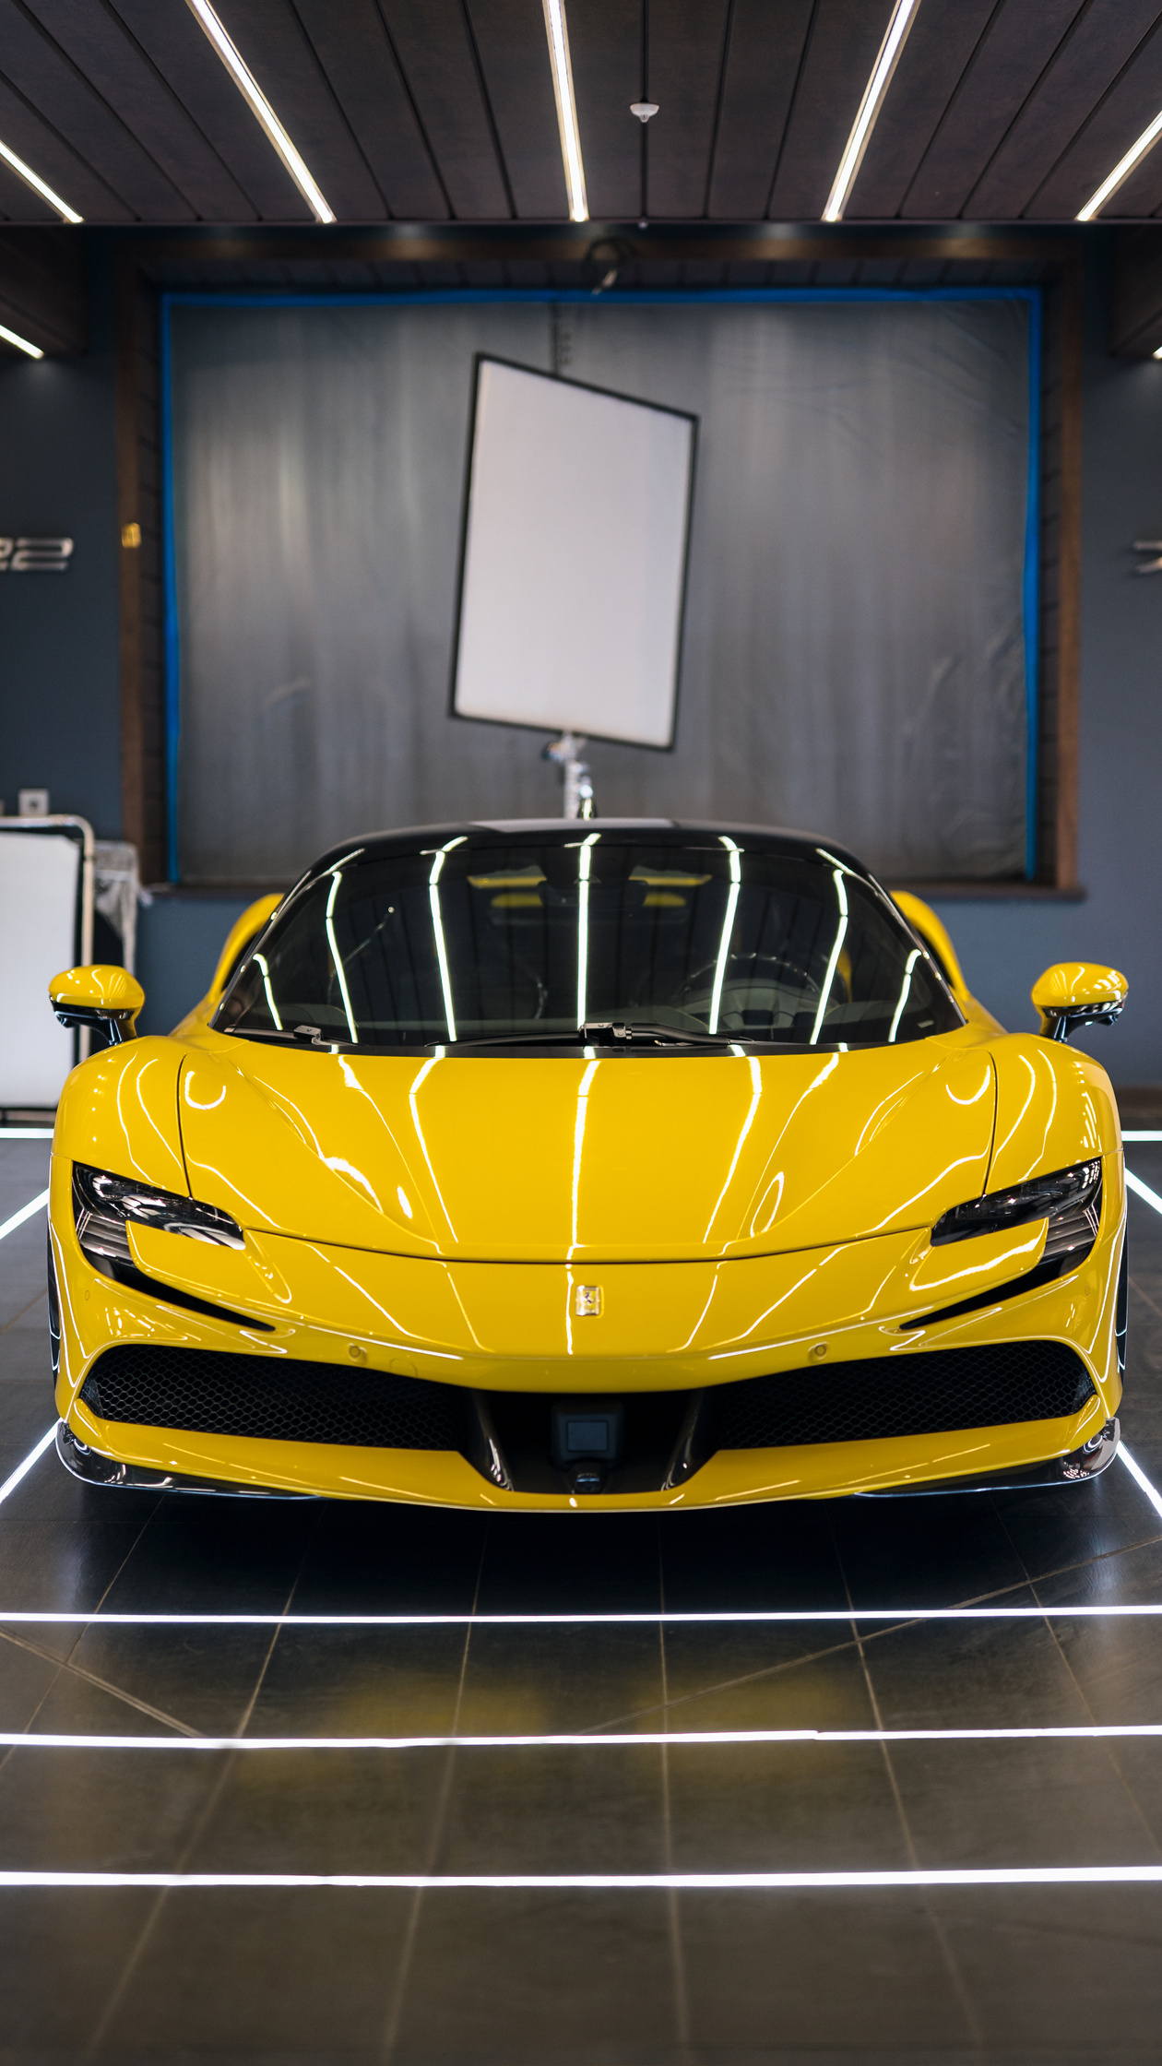
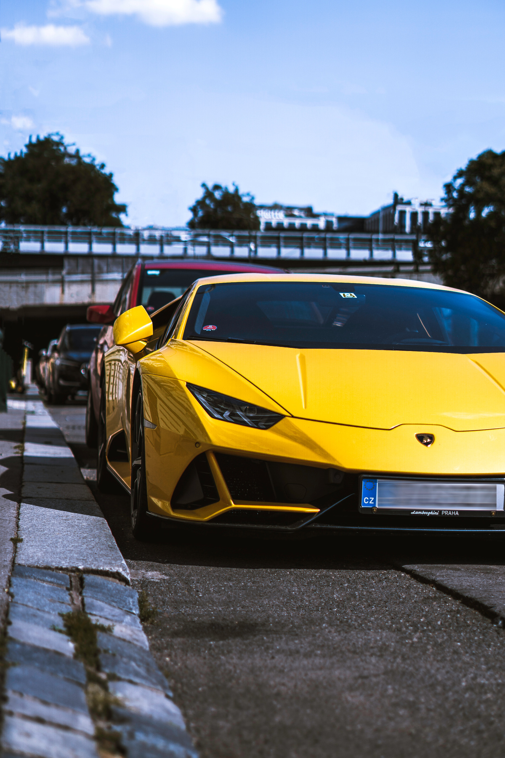
Data
Augmentation
Purpose:
Expands dataset variability to improve model generalization and .
Techniques Applied:
Image flipping (mirrors left/right turns).
Adjusting brightness to simulate different lighting conditions.
Cutout random parts of the image
Zooming randomly.
Panning
6

Slide 11
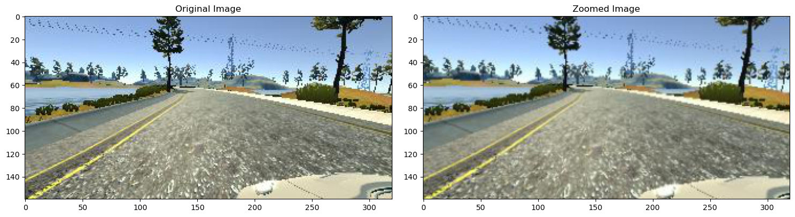
Data
Augmentation
Zoom:
6

Slide 12
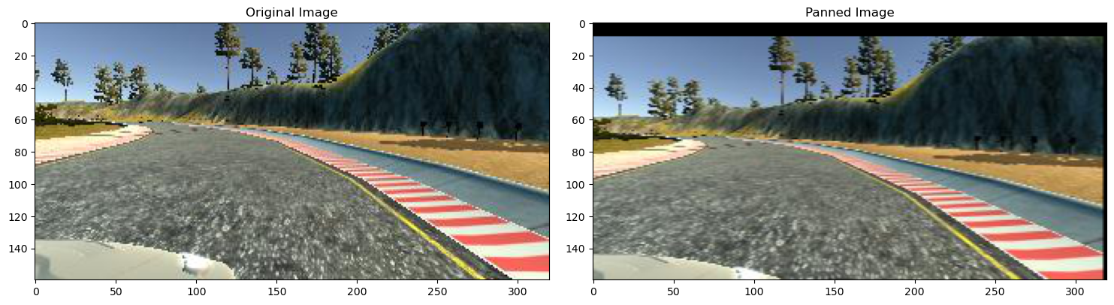
Data
Augmentation
Pan:
6

Slide 13
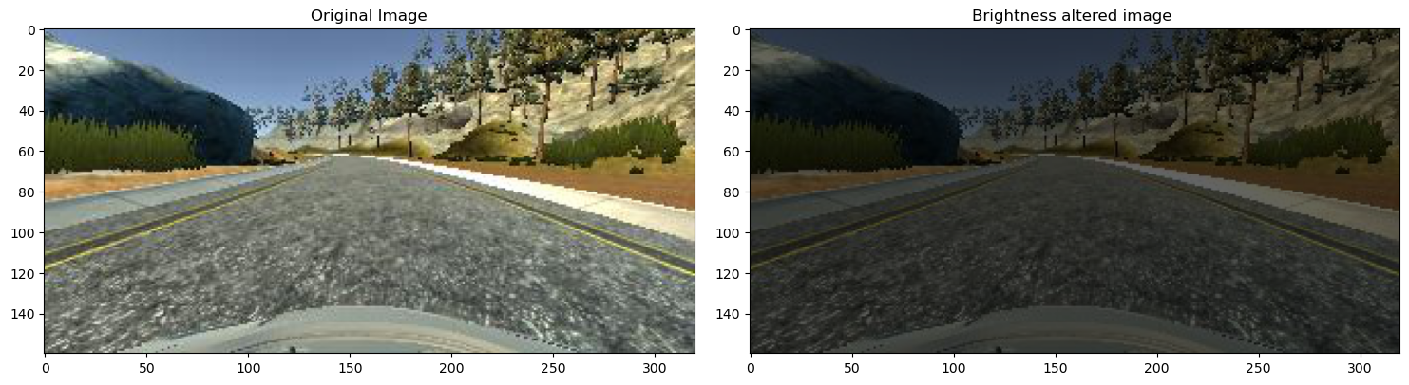
Data
Augmentation
Brightness altering:
6

Slide 14
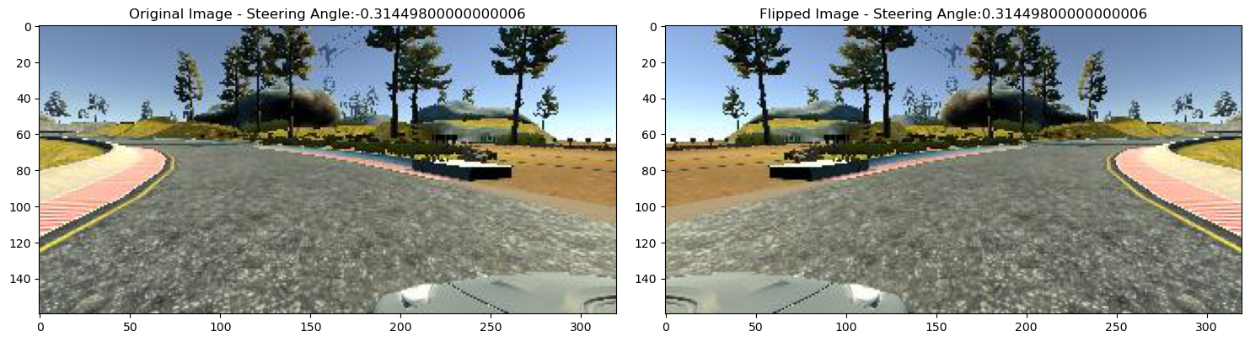
Data
Augmentation
Flip:
6

Slide 15
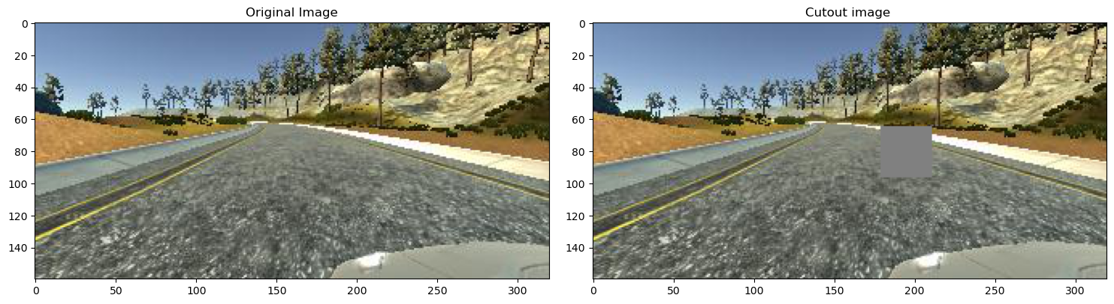
Data
Augmentation
Cutout:
6

Slide 16
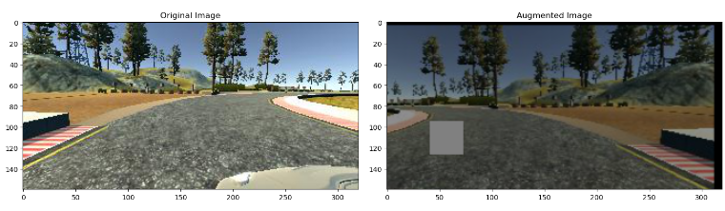
Data
Augmentation
Random Augmentation:
6

Slide 17

Data Preprocessing
Changing color Format
YUV format is better for the model according to Nvidia
Cropping:
Removes non-relevant areas to focus on the road.
7

Slide 18
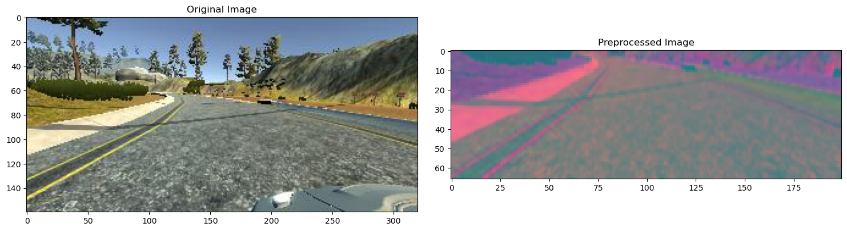
Data Preprocessing
7

Slide 19
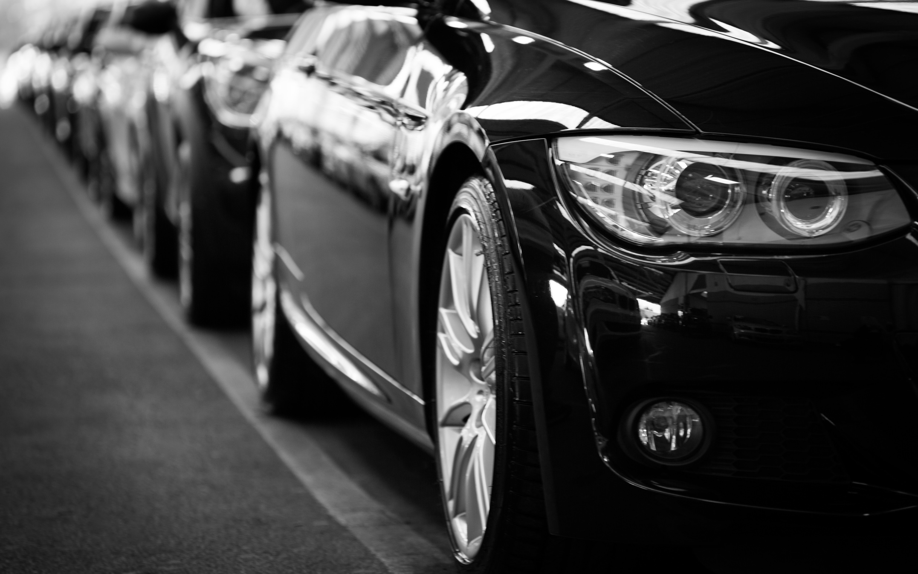
Batching
Why Batching?
Improves training efficiency by processing multiple images at once.
Reduces memory load on GPUs.
Batch Size Optimization:
Finding an optimal balance between computational speed and model performance.
8

Slide 20
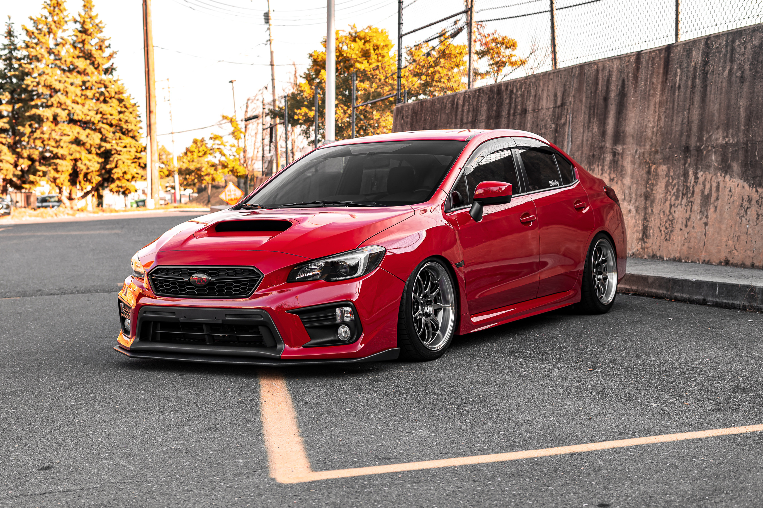


Model Structure
CNN-based Architecture:
Key Components:
ELU activation function to introduce non-linearity.
Output layer predicting steering angles
9

Slide 21
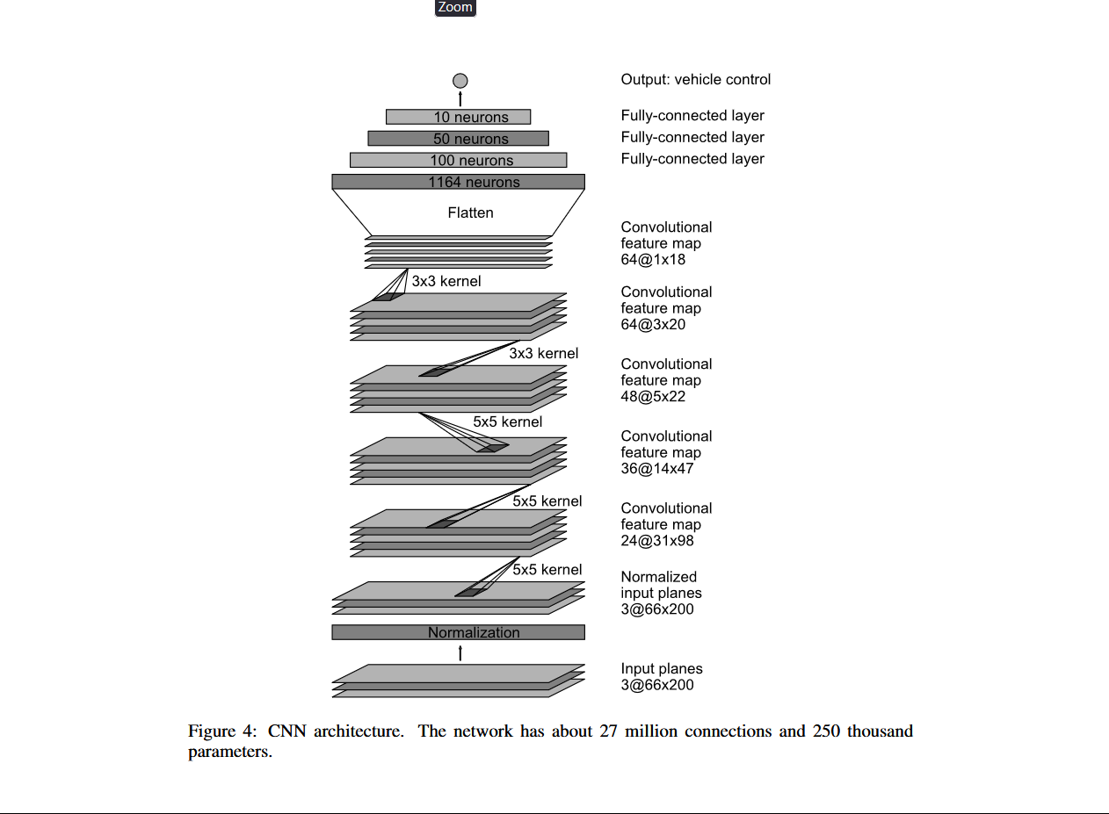
Model Structure
9

Slide 22
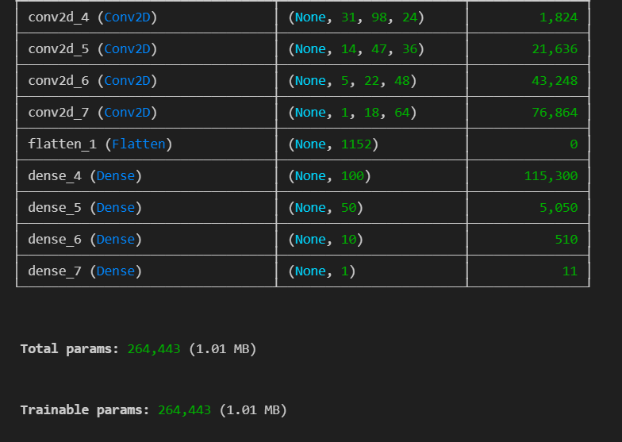
Model Structure
9

Slide 23
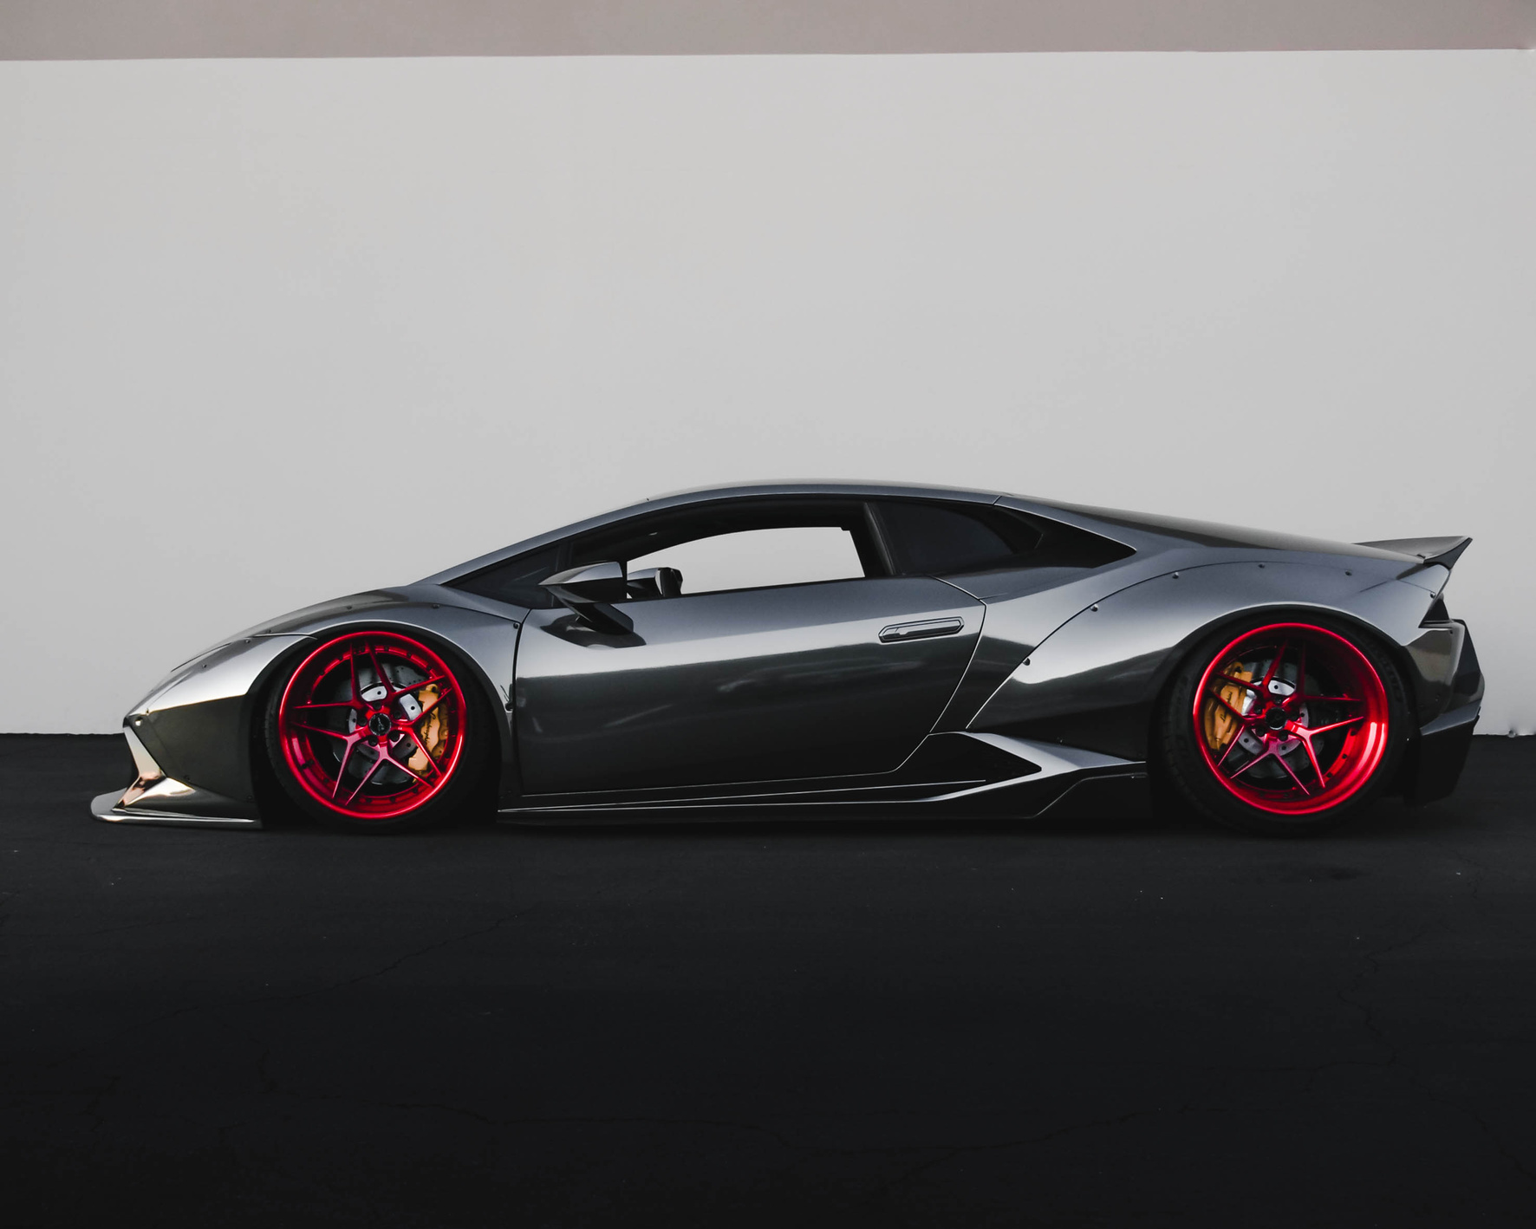
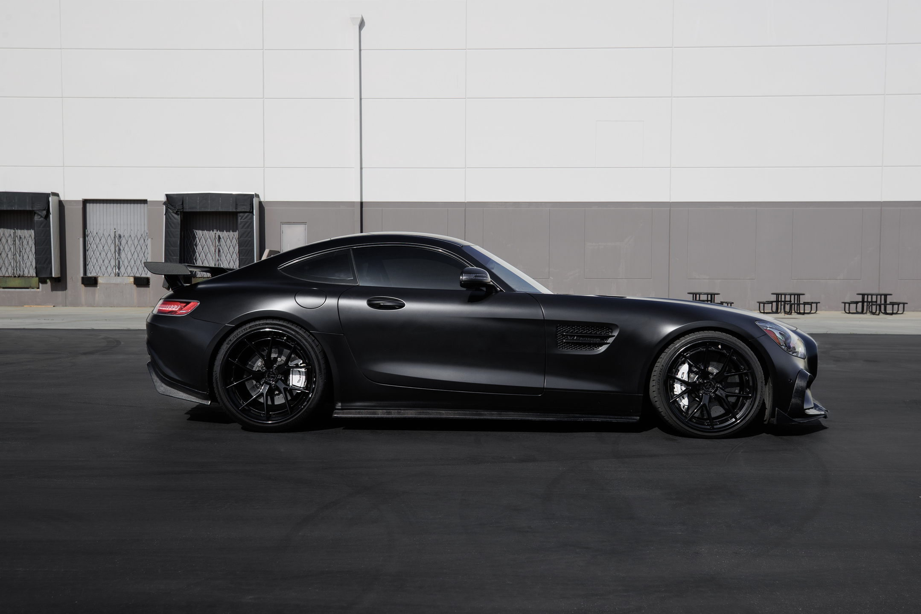
Training and Results
Training Process:
Split data into training and validation sets.
Optimized using Adam optimizer and MSE loss function.
Results Analysis:
Performance evaluated using loss curves.
10

Slide 24
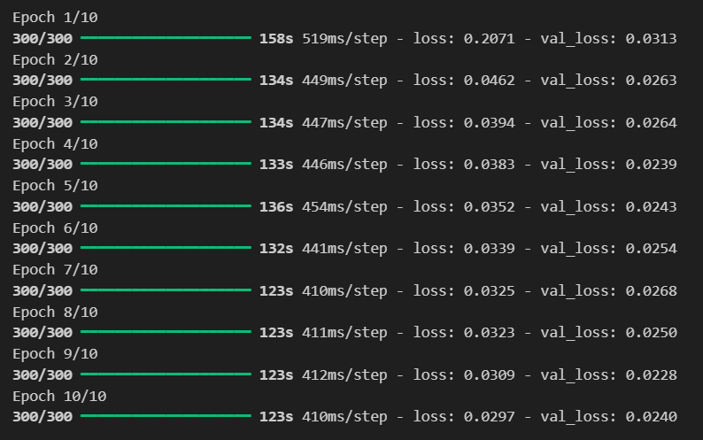
Model Analysis
9

Slide 25
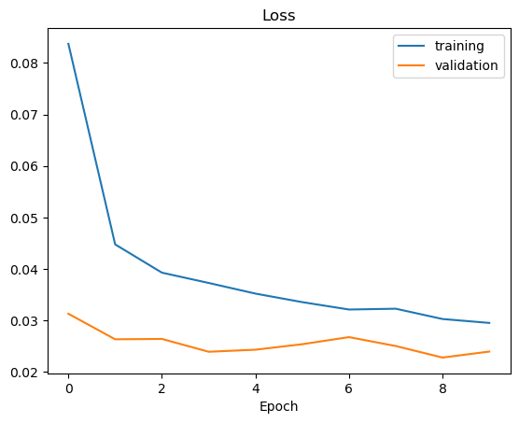
Model Analysis
9

Slide 26
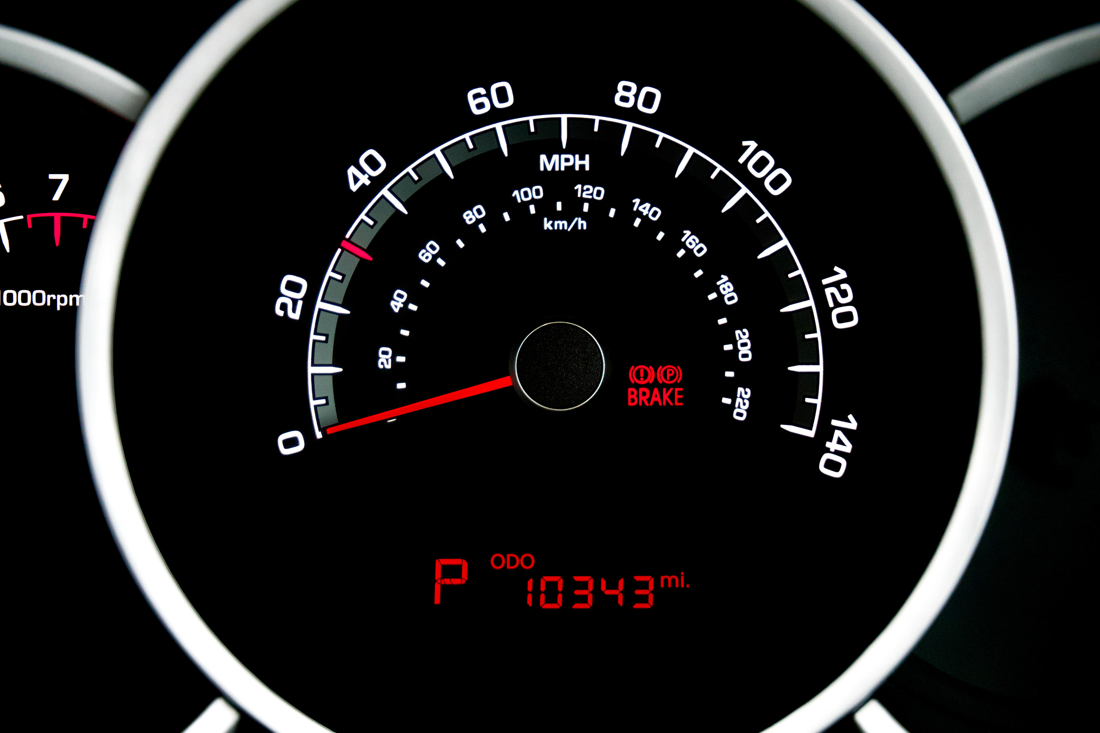
Script to Connect to the Simulator
How the Model Interfaces with the Simulator:
Receives the photos taken by the three cameras in real time
Applying image preprocessing and feeding it to the model to get prediction
Sends steering predictions to the simulator in real-time.
Uses socket communication for seamless integration.
11

Slide 27
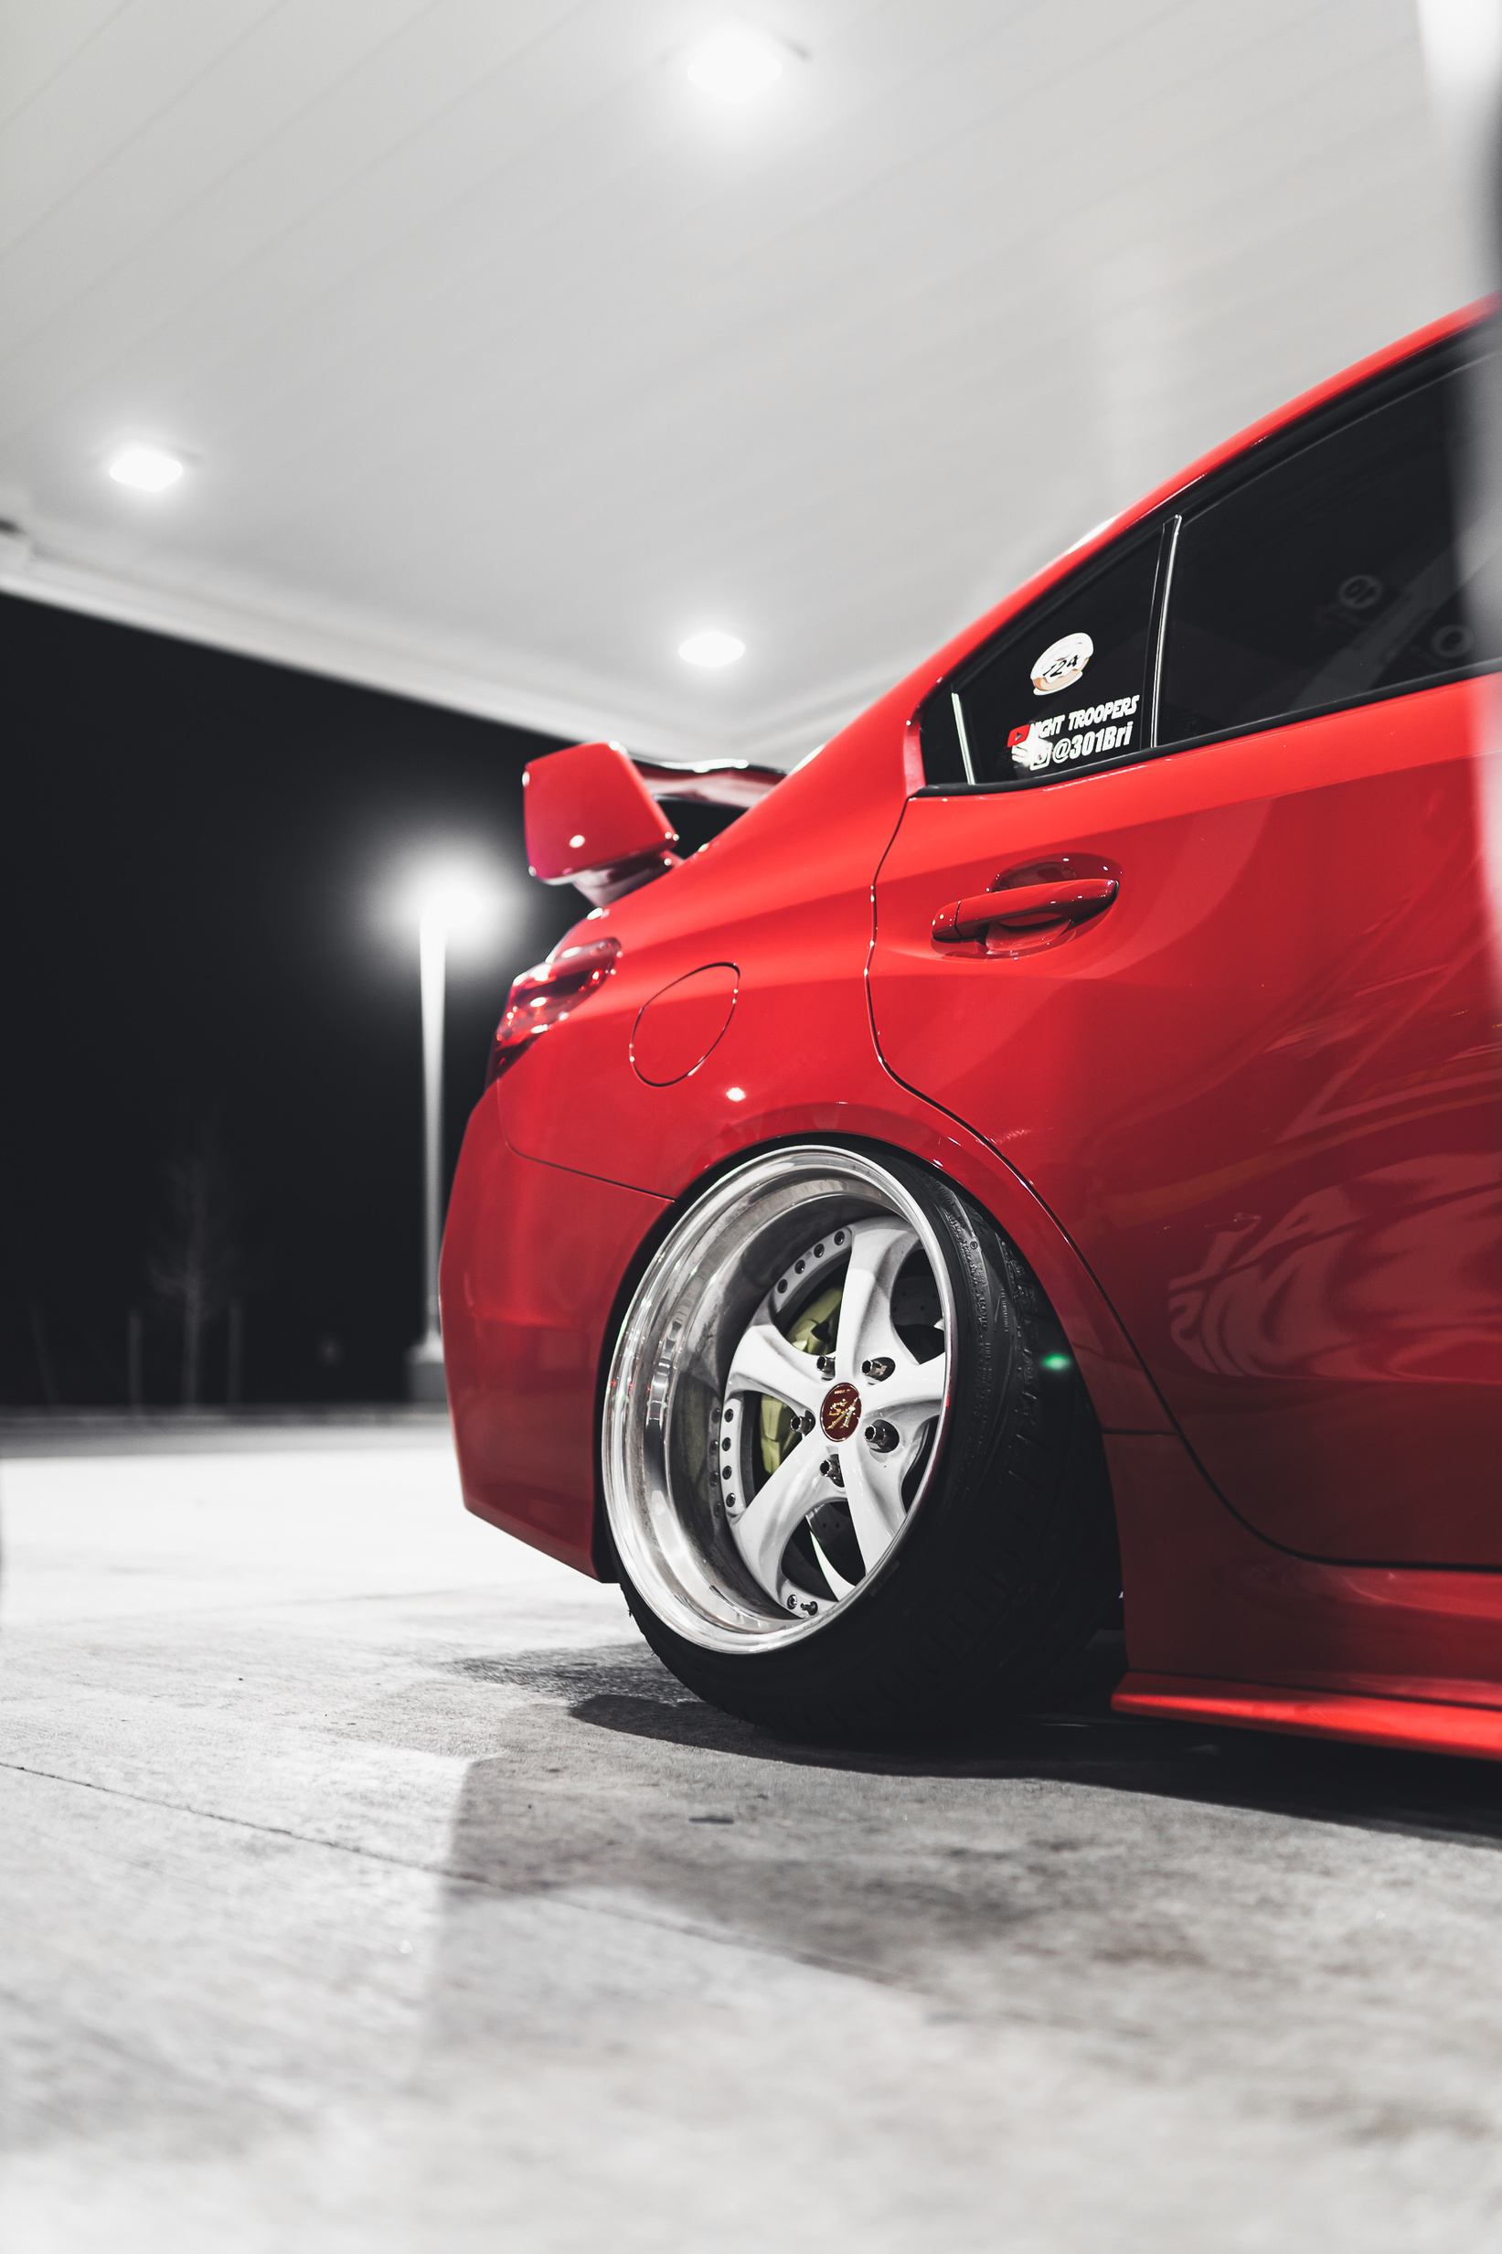
Showcasing the Model in Action
Demonstration of Self-Driving Behavior:
Visualization of input images and predicted steering angles.
Real-time performance evaluation in the simulator.
9

Slide 28
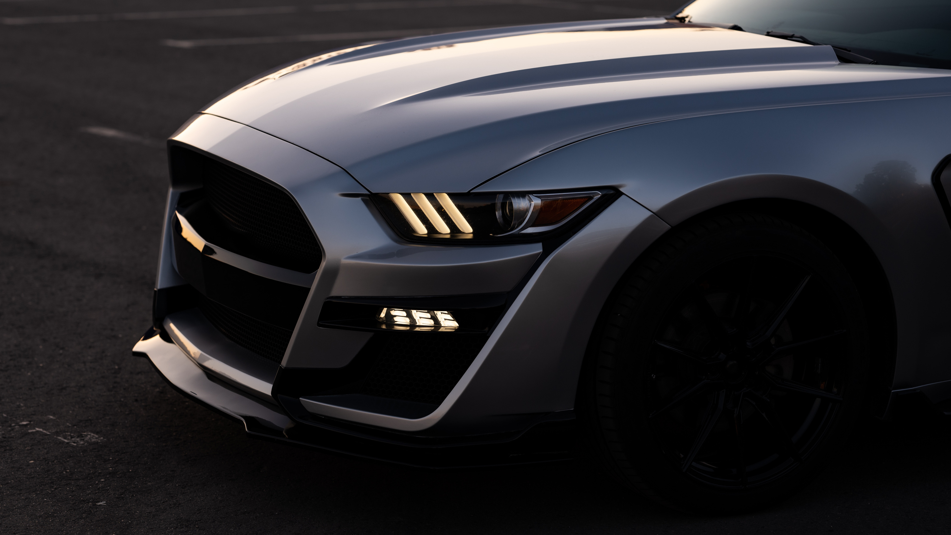
THANK YOU!
36

